Slide 1
Student Manages FAFSA® Contributors

Slide 2
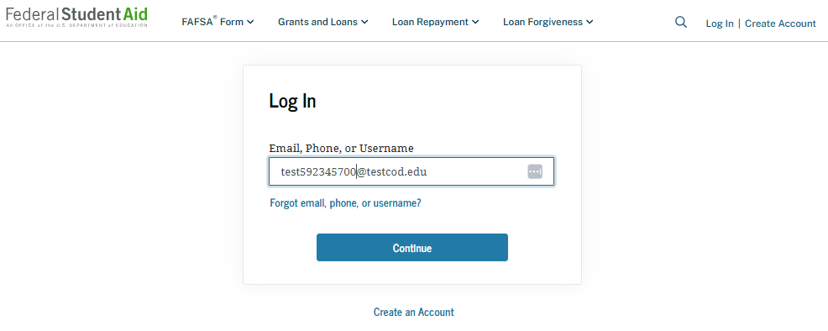
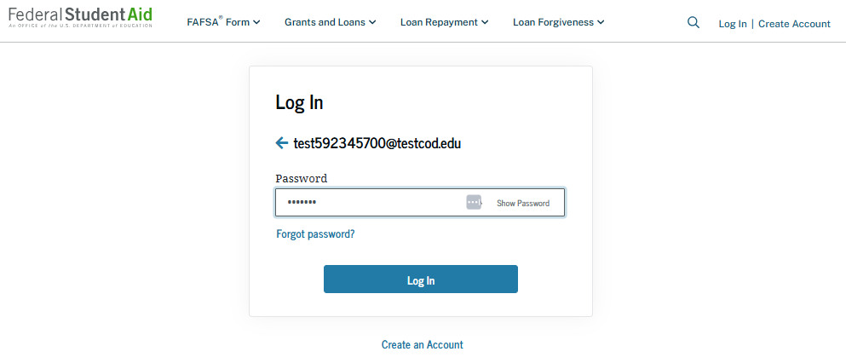
Manage FAFSA® Contributors: Log-in
To access an existing FAFSA® form, the student is required to have a StudentAid.gov account username and password.

Slide 3
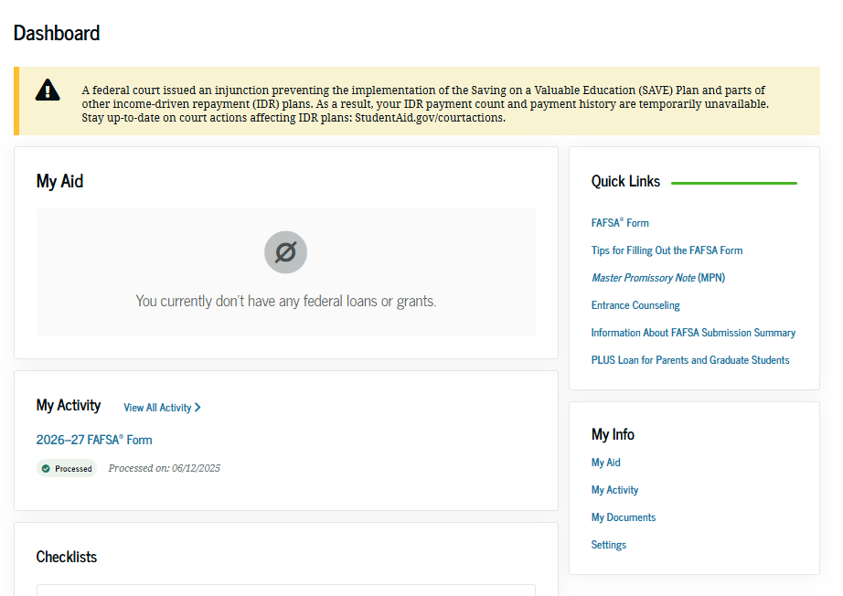
Manage FAFSA® Contributors: Dashboard
On the account Dashboard, the student can see their most recent 2026–27 FAFSA® activity under the "My Activity" section. In this scenario, the student has a processed 2026–27 FAFSA form. To see further information about this application, the student selects the application and is taken to the "Details" page.

Slide 4
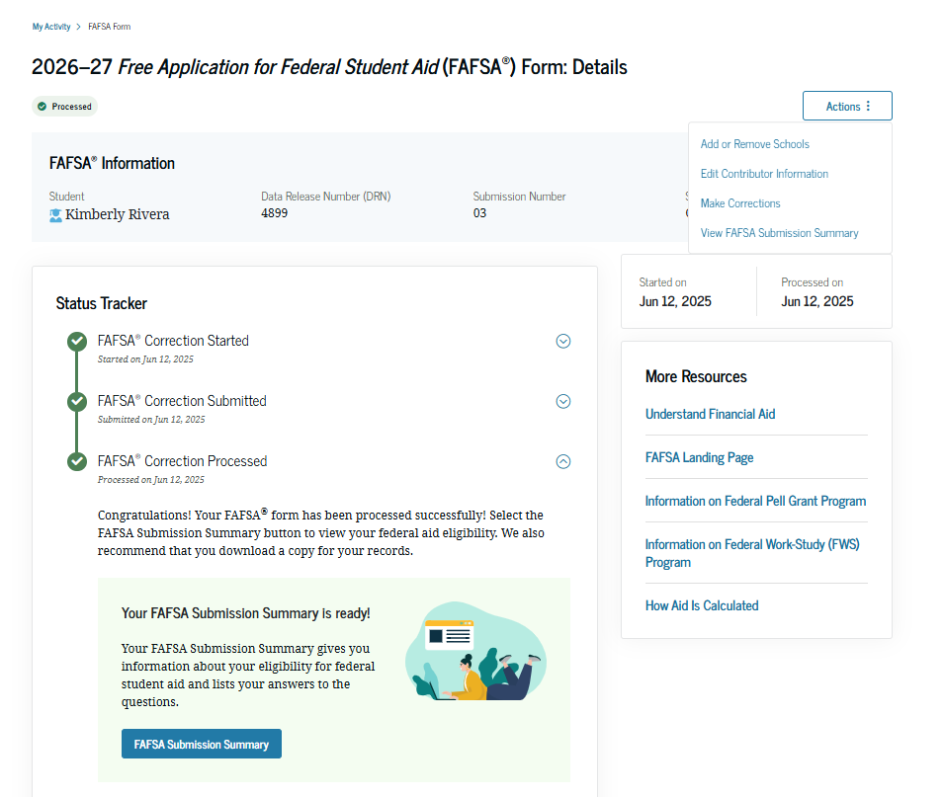
Manage FAFSA® Contributors: Details
On the "Details" page, the student sees information about their processed FAFSA® form, such as when it was started and processed, their FAFSA Submission Summary, and additional resources. If a required contributor was invited to the student’s form, the student can select "Edit Contributor Information" within the "Actions" menu. This option allows the student to resend the invitation if they provided the wrong information for a contributor.

Slide 5
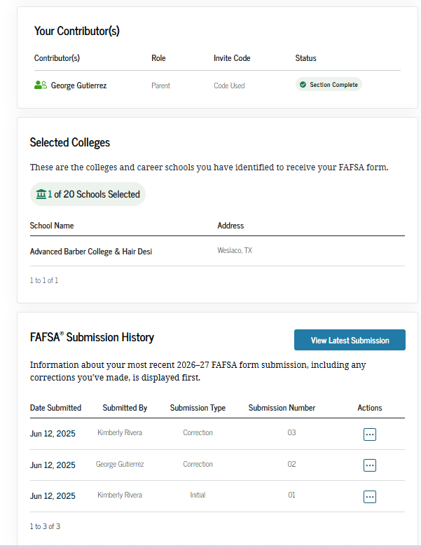
Manage FAFSA® Contributors: Details (Continued)
Farther down the "Details" page, the student sees their invited contributor(s), selected school(s), and FAFSA® submission history. In this scenario, the student selects "Edit Contributor Information" within the "Actions" menu to resend an invitation to their parent.

Slide 6
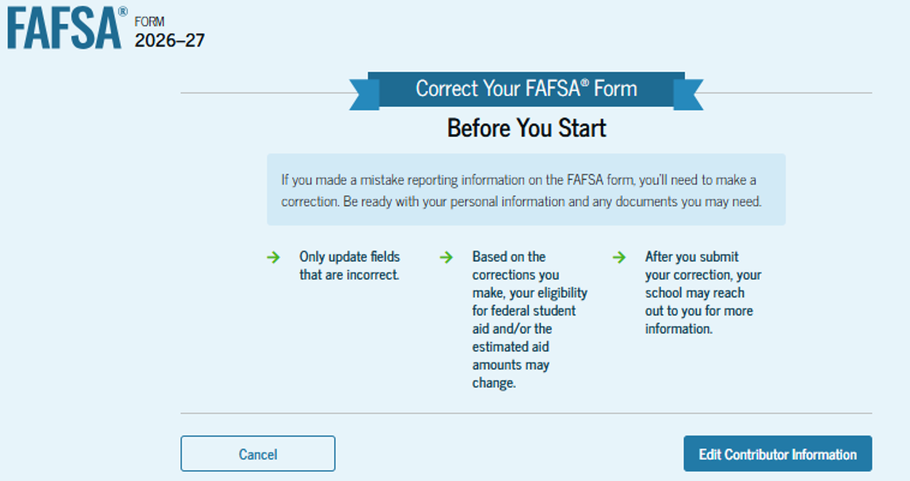
Manage FAFSA® Contributors: Onboarding
When the student starts a 2026–27 FAFSA® correction, they are taken through the FAFSA correction onboarding process. A correction should only be submitted if critical information was missing, the form contains incorrect information, the student needs to update the selected school(s), and/or a financial aid administrator requested a correction.

Slide 7
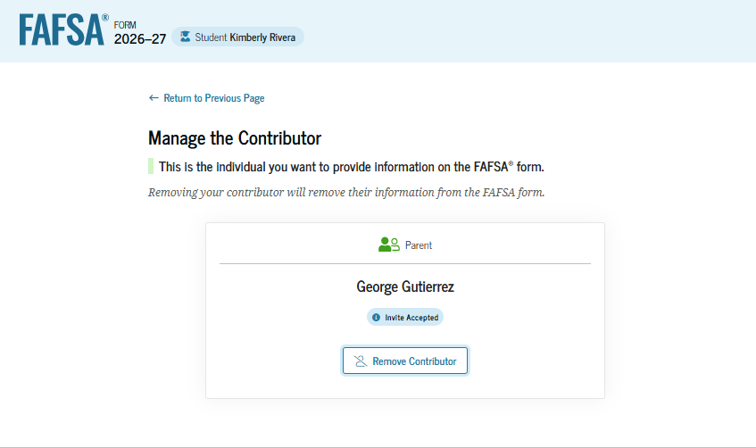
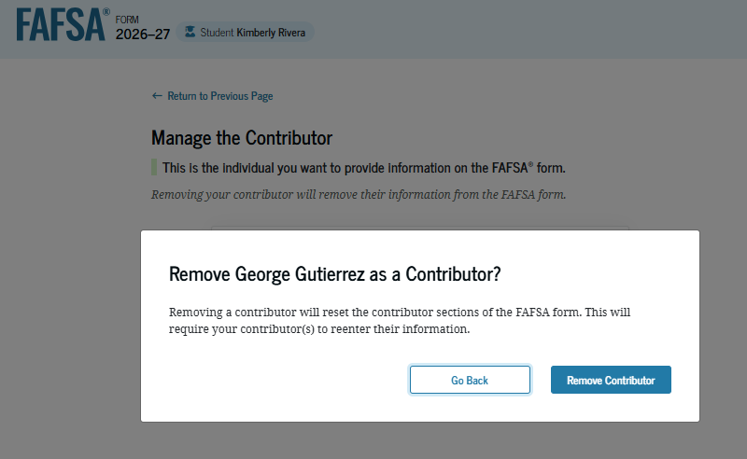
Manage FAFSA® Contributors: Remove Contributor
This page displays the invitation that was sent on the processed form. When the student selects "Remove Contributor" on their parent’s invitation, a message displays informing the student that by choosing to remove their parent as a contributor, the parent sections on the FAFSA® form will be reset and a new invitation will be sent. The student confirms by selecting "Remove Contributor."

Slide 8
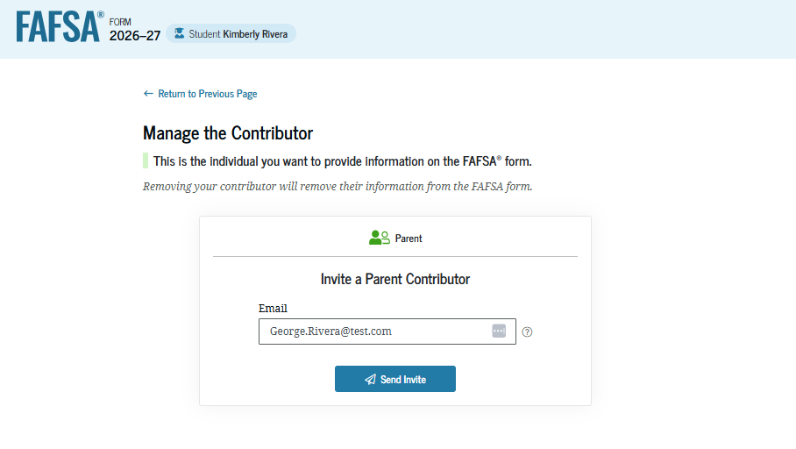
Manage FAFSA® Contributors: Update Contributor Details
The student can provide an updated email address for their parent and send a new invitation. As a result, any information provided in the parent sections will be reset. The parent will have to accept the new invitation, provide consent and approval (if not previously provided), and provide their signature for the student’s FAFSA® form to be processed successfully.

Slide 9
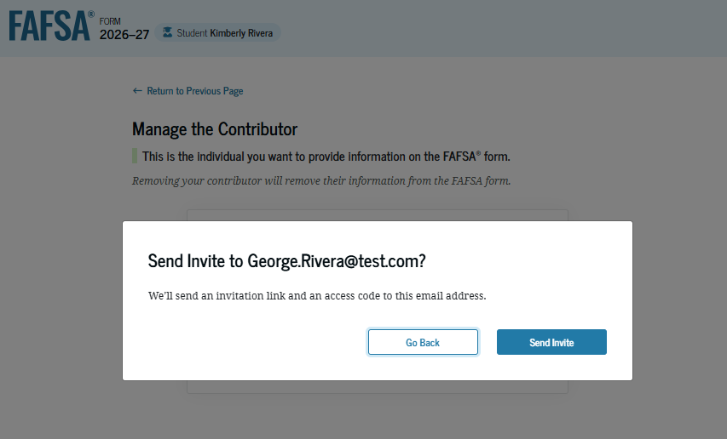
Manage FAFSA® Contributors: Update Contributor Details (Continued)
When the student selects "Send Invite," a message displays, asking the student to confirm their parent’s email address. To confirm the updated information and send the new contributor invite, the student selects "Send Invite."

Slide 10
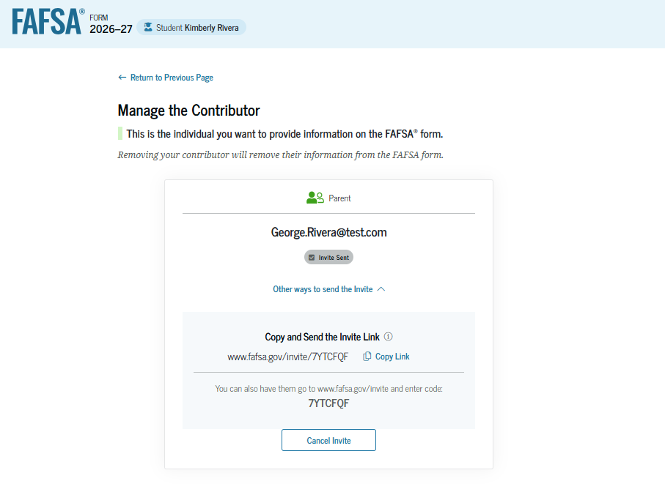
Manage FAFSA® Contributors: Invite Sent
This page informs the student that the invite to their parent has been sent. The parent will receive an email inviting them to enter the FAFSA® form to complete their required sections. The student is also provided an invite link and invite code on this page that can be shared directly with the parent.

Slide 11
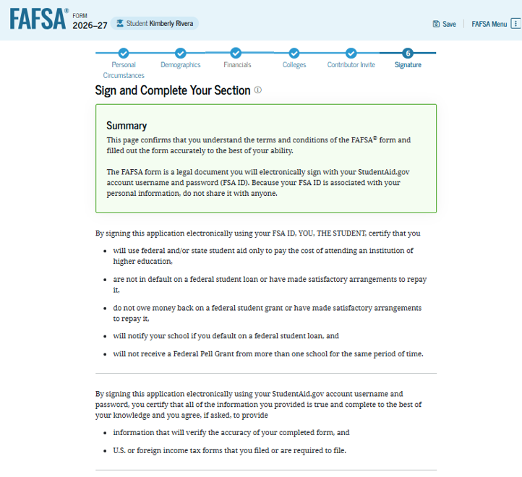
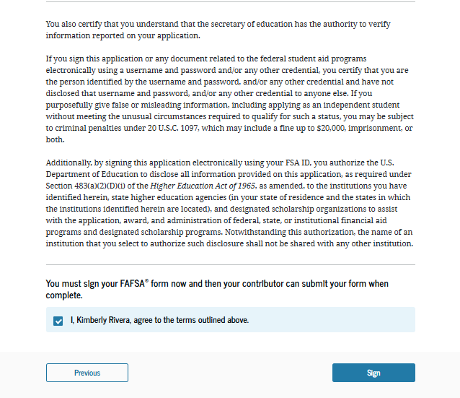
Manage FAFSA® Contributors: Signature
On this page, the student acknowledges the terms and conditions of the FAFSA® form, digitally signs, and submits the correction.

Slide 12
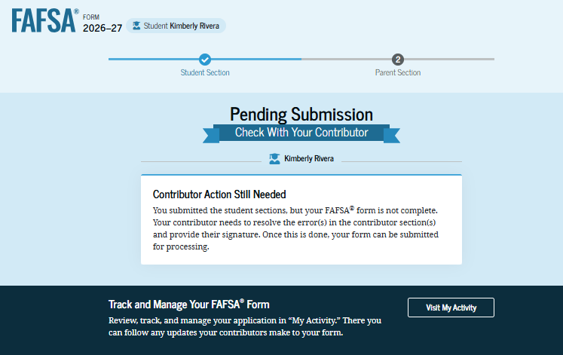
Manage FAFSA® Contributors: Confirmation
After signing their FAFSA® form, the student has submitted the correction and is presented with the confirmation page. This page displays information for the student about next steps, including tracking their FAFSA form and corrections. The student is informed that the form is not complete because the parent needs to resolve one or more errors in the contributor section(s) and sign their section of the form.

